Slide 1
Shared Medical Appointments (a.k.a. Group Visits) Facilitator Training Workshop
Prof. Garry Egger AM MPH PhD FASLM
Ass/Prof John Steven RN PhD FACN

Slide 2
Learning Outcomes
Outline the conditions and situations for which SMAs have been used effectively according to the literature.
Explain what an SMA is and how it differs from traditional 1:1 consultations and group education.
Differentiate the role of the doctor, the facilitator and the optional documenter in the SMA process.
Analyse the perceived barriers/challenges associated with the implementation and delivery of SMAs.
Conduct a ‘continuous improvement’ SMA debrief to systematically address any safety concerns, identify knowledge gaps and areas for improvement.

Slide 3
Outline of Session 1
Background/rationale for a new approach in primary care
SMAs and where they fit in chronic disease management
Outcomes, incomes, benefits and perceived barriers to running SMAs in your practice

Slide 4
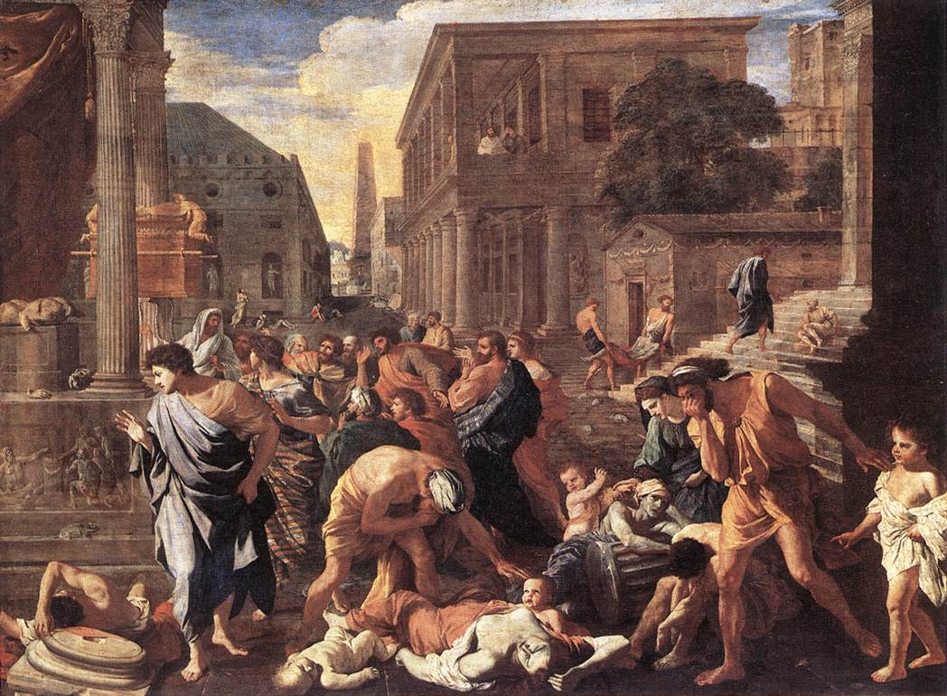
Infectious (Communicable)
Disease Era: 0 - ~1950

Slide 5
Temporal Trends in Disease Epidemiology
Causes:
Hygiene; sanitation; water;
micro-organisms
Acute diseases
Mortality and Morbidity
Causes:
Lifestyle; environment;
economic development
Chronic Diseases (NCDs)
Late 19thCentury
Early 21stCentury
Time
Sagner et al., Int J Clin Pract, 2014, 68:11, 12-89-1292

Slide 6
Chronic (Non-Communicable)
Disease Era: 1980 - ?

Slide 7
Chronic disease categories with lifestyle/environmental determinants
?

Slide 8
Chronic disease categories with lifestyle/environmental determinants
(1) Cardio and cerebro-vascular disease
(2) Cancers with lifestyle component
(3) Endocrine/metabolic disorders
(4) Gastrointestinal diseases
(5) Kidney disease
(6) Mental/CNS health
(7) Musculoskeletal disorders
(8) Respiratory diseases
(9) Reproductive disorders
(10) Dermatological disorders

Slide 9
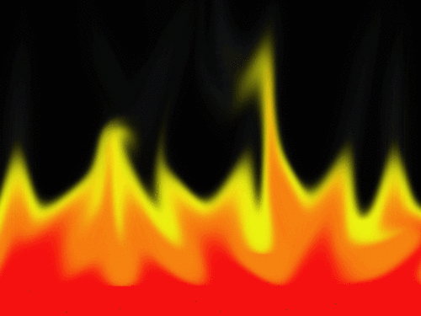
Classical Inflammation vs ‘Metaflammation’
Basal Homeostasis
Resolution
Microbial
Pathogen/
‘Antigen’
Lifestyle/
Environmental
‘Inducer’
Immune Reaction
Chronic
Allostasis
‘Agent’ (LDL)
Oxidative
stress
Immune
Defense
‘Dys-
Metab
Olism’
Disease
‘Meta-
flammation’
Insulin
Resistance
Inflammation
Classical, Acute,
Infectious Response
Modern, Chronic.
Non-infectious Response
Ref: Egger G, Dixon J. Brit J Nutr 2009;18:1-5
Notes:
There are two forms of inflammation that result from ‘insult’ or injury 1. Classical inflammation has been known about for 2,500 years. It happens when a microbial pathogen or ‘antigen’ causes the inflammation (fire) around the invading organism to confine it and stop it from spreading. The immune defense system them comes into play (killer T cells etc) which attack the antigen, eventually killing it and returning the body to homeostasis. The newer form of inflammation 2. was only discovered in 1994. It doesn’t have an ‘antigen’ or live microbial ‘cause’, but is caused by a lifestyle or environmental ‘inducer’ (which is usually a lifestyle or environmental ‘cause’ such as nutrition, inactivity, stress etc., as shown in the hierarchy of disease slide. This causes a low level inflammation response (shown by the smouldering ashes), which leads on to dysmetabolism, ‘allostasis’ (the opposite to homeostasis) and eventually chronic disease.

Slide 10
Lifestyle Medicine
“A form of health promotion and branch of medicine targeting prevention and management of environmentally-induced lifestyle related diseases.”
(Global Lifestyle Medicine Association 2014)

Slide 11
Lifestyle Medicine
McGraw-Hill, Sydney
1st Ed 2010
McGraw-Hill, Sydney
2nd Ed 2011
Academic Press, London
3rd Ed 2017
www.elsevier.com
www.lifestylemedicine.org.au

Slide 12
Components of Lifestyle Medicine
1. Knowledge (the science)
(ie. what are the lifestyle/environmental ‘determinants of chronic disease?)
2. Skills (the art)
(ie. what are the skills/practices for changing unhealthy lifestyles/ environments?)
3. Tools (the materials)
(ie. what tests/devices/equipment can be used to assist changes towards a healthy lifestyle and/or environment)
4. Procedures (the actions)
(ie. what sequence of steps needs to be taken to establish a course of action to improve unhealthy lifestyles/environments)
Egger, G., et al., (2017) ‘Lifetsyle Medicine’

Slide 13
Knowledge (The Science): ‘Determinants’ of Chronic Disease
* Level of evidence for ‘Metaflammatory Response – Independent of obesity
M
A
L
*
eaninglessness – ‘learned
helplessness
lienation– from society
oss of culture/identity
N
A
S
*
utrition - excess energy, fat,
sugar, salt; malnutrition etc.
ctivity - inactive leisure &/or
work time; excessive sitting.
tress - ‘burn-out’, ‘brown out’,
anxiety, depression.
***
O
D
O
U
R
S
***
ccupation – shift work; occupation
hazards etc.*
rugs and alcohol –iatragenesis;
recreational drugs.
ver exposure – sunlight,radiation.
nder exposure- light, sunlight.
elationships – support; social
inequality etc.
ocial inequality – ratio between
rich and poor.
**
***
T
I
E
***
echnology-induced-pathology –
adverse effects of technology.
nadequate Sleep – sleep
disorders; sleep time.
nvironment -
air pollution; endocrine
disrupting chemicals, injury.
*
**
***
**
***
**
***
ANTHROPOGENS:
“Man-made environments, their by products and/or lifestyles
encouraged by these that may be detrimental to human health”
Egger, G., et al., (2017) ‘Lifestyle Medicine’

Slide 14
A Hierarchy of Disease ‘Causality’
Determinants
DISTAL
(‘Upstream’)
MEDIAL
(‘Midstream’)
PROXIMAL (‘Downstream’)
RISK
FACTORS/
MARKERS
Obesity
BP
Lipids
High FPG
IGT
hsCRP
HBA₁C
Inflammation
etc.
DISEASE
T2 Diabetes
CHD
Stroke
Cancers
etc.
(Chronic
Diseases)
Metafla mation
NASTIE MAL ODOURS
Notes:
It’s a mistake to think that there is a single cause of chronic disease. Instead there’s a ‘hierarchy of ‘causality’. This is shown in the sequence of animations here: 1. First there is the disease (short list shown here) 2. These all seem to have ‘metaflammation’as an underlying physiological component. 3.Then there are ‘risk factors’ or markers for these diseases 4. But there are a range of ‘determinants’ (not really ‘causes’ in chronic disease) 5. First, there are the ‘proximal’ (downstream) risk factors, which are closest to the disease (this is one ‘cause’) 6. But there are ‘causes’ of these and these are ‘medial’ or midstream, 7. but these also have ‘causes’ and these are called ‘distal’ or the ‘cause of the cause of the cause’). And this is where most analysis usually ends, but 8. somewhere between the distal and other levels of causality are the psychological factors that are important for displaced societies. These are Meaningless, Alienation and Loss of Culture and Identity, which are appropriate for Indigenous cultures. 9. All of the determinants underlined here add up to the acronym NASTIE MAL ODOURS, which is a way of remembering them.

Slide 15
A Hierarchy of Disease ‘Causality’
Determinants
DISTAL
(‘Upstream’)
Environment
(Physical,
Political,
Economic,
Socio-
cultural)
MEDIAL
(‘Midstream’)
PROXIMAL (‘Downstream’)
RISK
FACTORS/
MARKERS
Obesity
BP
Lipids
High FPG
IGT
hsCRP
HBA₁C
Inflammation
etc.
DISEASE
Stress (Anxiety
Depression)
Inadequate sleep
Technology
Induced pathology
Occupation
Relationships
(peer pressure)
Inequality
Social Inequity
Nutrition
(In) Activity
Drugs, alcohol,
smoking
Over-exposure
Under-exposure
T2 Diabetes
CHD
Stroke
Cancers
etc.
(Chronic
Diseases)
Meaninglessness, Alienation,
Loss of culture/Identity
Metafla mation
‘Cause’ of
the ‘cause’ of
the ‘cause’
‘Cause’ of
the cause’
‘Cause’
NASTIE MAL ODOURS
Notes:
It’s a mistake to think that there is a single cause of chronic disease. Instead there’s a ‘hierarchy of ‘causality’. This is shown in the sequence of animations here: 1. First there is the disease (short list shown here) 2. These all seem to have ‘metaflammation’as an underlying physiological component. 3.Then there are ‘risk factors’ or markers for these diseases 4. But there are a range of ‘determinants’ (not really ‘causes’ in chronic disease) 5. First, there are the ‘proximal’ (downstream) risk factors, which are closest to the disease (this is one ‘cause’) 6. But there are ‘causes’ of these and these are ‘medial’ or midstream, 7. but these also have ‘causes’ and these are called ‘distal’ or the ‘cause of the cause of the cause’). And this is where most analysis usually ends, but 8. somewhere between the distal and other levels of causality are the psychological factors that are important for displaced societies. These are Meaningless, Alienation and Loss of Culture and Identity, which are appropriate for Indigenous cultures. 9. All of the determinants underlined here add up to the acronym NASTIE MAL ODOURS, which is a way of remembering them.

Slide 16
A Systems Approach to Chronic Disease
Medication and/or Monotherapy
M
A
C
R
O
E
N
V
I
R
O
N
M
E
N
T
LEANNESS/GOOD HEALTH
= Diet/exercise etc.
Activity
Nutrition
Stress
Drugs/Alcohol
Techno-pathology
Environment
Social inequity
Occupation
Inadequate
Sleep
Over-Under
Exposure
Relationships

Slide 17
4. Procedures- The Action
Shared Medical Appointment
“..individual medical consultations carried out sequentially
with a number of patients, administered by a skilled
Facilitator, with others with similar concerns listening
and contributing. ”
8-15 pts
SMA TEAM @ 90 min
Doctor
Facilitator
Practice Nurse
Documenter

Slide 18
Outline of Session 1
1. Background/rationale for a new approach in primary care
2. SMAs and where they fit in chronic disease management
3. Outcomes, incomes, benefits and perceived barriers to running SMAs in your practice

Slide 19
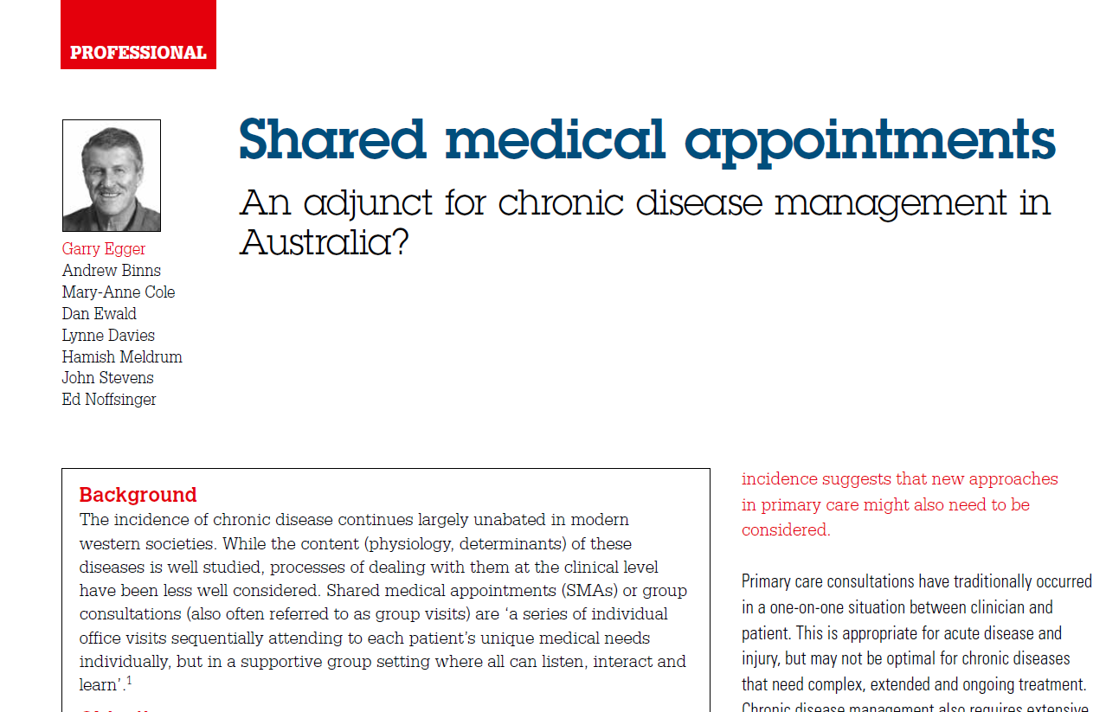
Where SMAs Fit
Clinical
care
(1:1)
1 Doc; 1 Patient
Shared Medical
Appointments
1 Doc; 1 Facilitator
6-12 patients
Group
education
(1:X)
1 Educator;
15-20 patients
Egger et al., Aust Fam Physician. 2014 Mar; 43(3):151-4.

Slide 20
“SMAs are like ‘Medical Moais’”
Dr Rob Lawson, CEO; BSLM
(Moai is Japanese for ‘meeting for a common purpose’. The term comes from social support groups in Okinawa)

Slide 21
Conventional 1:1 medical/health interaction

Slide 22
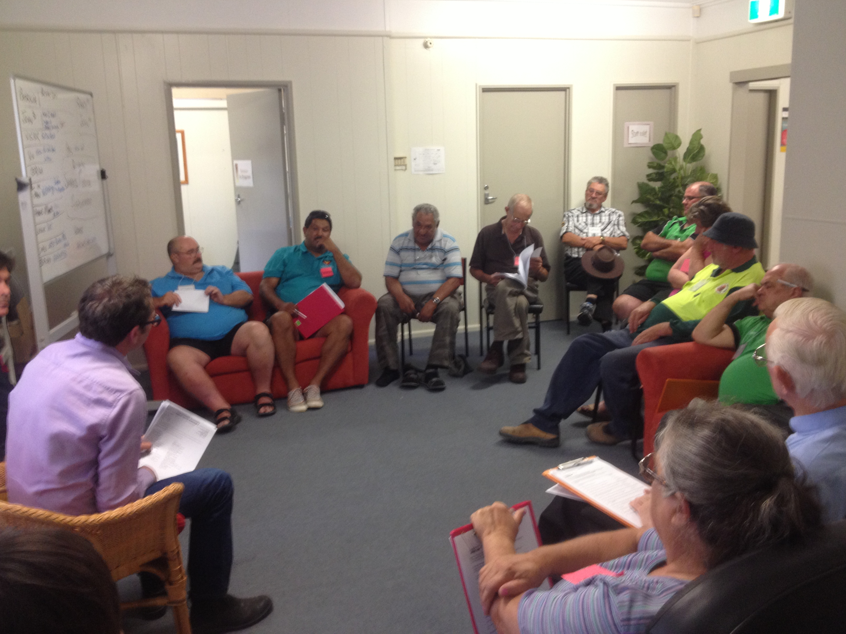
Layout of a typical Shared Medical Appointment (SMA)
Consulting Rooms
Facilitator
Doctor
Documenter

Slide 23
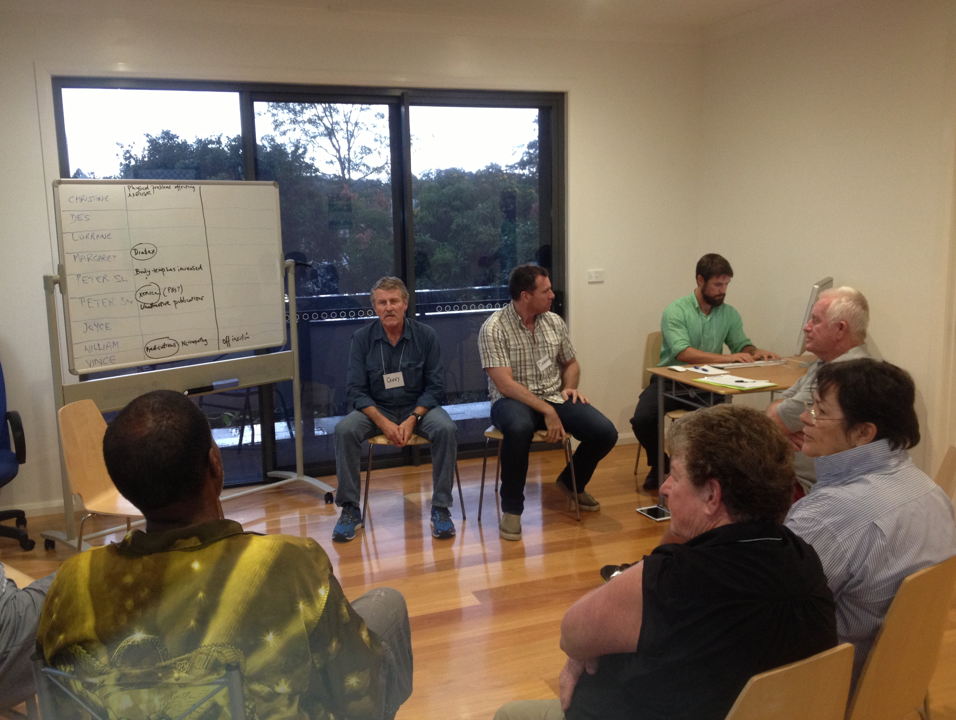

Slide 24
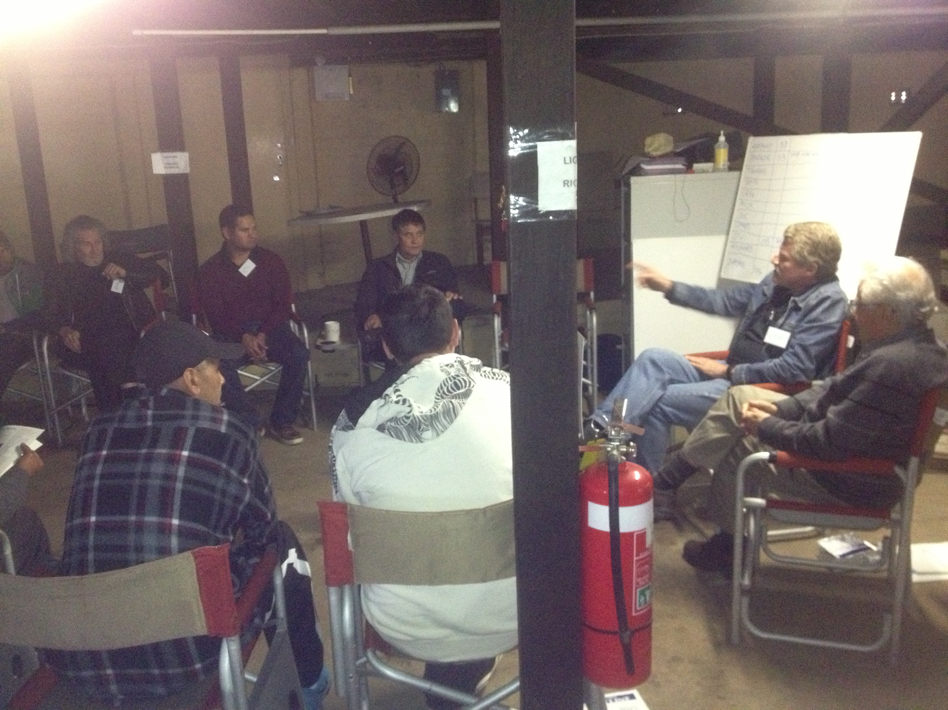

Slide 25
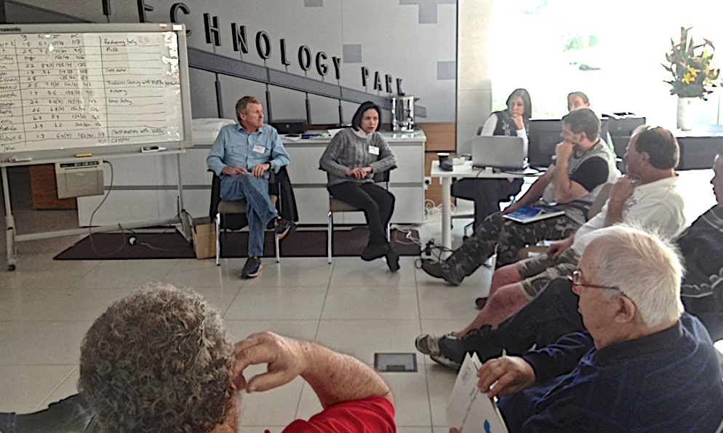

Slide 27
Canadian Video
https://www.youtube.com/watch?v=mCmj2ygPeyo

Slide 28
Q&A
E/J

Slide 29
Shared Medical Appointments (Group Visits)
G

Slide 30
Background to SMAs
• Began in the USA with Dr Ed Noffsinger (‘The ABC of
group visits’ (2012); ‘Running group visits in your practice’ (2010)’
• Used in the Netherlands, Italy and Norway to increase patient
compliance (mainly Type 2 Diabetes)
• Thought not to be possible in Australia because of MBS, but
trialed under an RACGP grant in 2013-14, with high patient and
provider satisfaction.
• Taken to UK in 2016 (now in >200 medical Centres).
There are now over 600 papers on SMAs published, generally
showing improvements over 1:1 clinical consults in a range of areas

Slide 31
Types of SMAs
• ‘Homogeneous’:
- Patients with similar diseases (eg. diabetes), ailments (eg. chronic pain), or categories (eg. metabolic syndrome)
- can be one-off, or regular
• Programmed SMAs (pSMAs)
“… a sequence of Shared Medical Appointments in a semi-structured form providing discrete educational input relating to a specific topic.”
- can be two, to X sessions, with & without doctor in some sessions
• DIGMAs (Drop in Group Medical Appointments)
- one-off sessions at regular intervals (eg. weekly) for opportune & unscheduled consultations with patients with heterogeneous problems
Egger et al., AFP, 2014, 43:3, 151-154
“If you’ve seen one Shared Medical Appointment…..you’ve seen one Shared Medical Appointment”
Dr Marianne Sumego
Director, SMAs, Cleveland Clinic

Slide 32
What type of SMA will you run?
Generic Type Composition
Physical Shared Medical
Appointments (PSMAs)
Includes a range of physical tests
by GP or PN in ‘breakout’ room
Heterogeneous Homogeneous
Shared Medical
Appointments
(SMAs):
Medical and Allied
Health consultation
and group session
with 6-12 patients
Varying gender/
age/ailment etc.
Pts with different
types of chronic
disease with
similar lifestyle
causes
(T2D; CHD,
COPD etc)
Similar ailment
or background
eg. T2D;
Indigenous men/
women; elderly
Programmed Shared
Medical Appointments
(pSMAs)
Ie. weight loss, smoking, pain,
restless babies, Type 2 diabetes etc.
Drop in Group Medical
Appointments
(DIGMAs):
Medical and Allied Health
consultation and group
session with 6-12 patients
Egger et al., AFP, 2014, 43:3, 151-154

Slide 33
SMA types: examples
Pediatric Diabetes | Cardiology (Preventative)
Pre-Diabetes care | Osteoporosis
Asthma | Sleep Medicine (CPAP)
Menopause | Pediatric Rheumatology
Wellness | CHF and Discharge
Pain Management | Weight Management
Adolescent weight | Diabetic foot care
PMSF | Medical Nutrition
Macular degeneration | Stroke
Diabetes | Heel pain
Bariatric | Psychiatry : Mood Disorders
Notes:
This shows the diversity and high lights the mix between primary care, preventative and specialties and areas we currently have SMA’s embedded into practice

Slide 34
Outline of Session 1
1. Background/rationale for a new approach in primary care
2. SMAs and where they fit in chronic disease management
3. Outcomes, incomes, benefits and perceived barriers to running SMAs in your practice

Slide 35
Outcomes from SMAs
Evidence for Improvements of Group Visits over 1:1 consults for:
• Type 2 diabetes (Riley and Marshall, 2010; Egger et al., 2015)
• Heart disease (Masley et al., 2001)
• Hypertension (Kawasaki et al., 2007)
• Arthritis (Shojania and Ratzlaff, 2010)
• The Disadvantaged (Clancy et al., 2003)
• Metabolic syndrome sufferers (Greer and Hill, 2011)
• Cancer recoverers (Visser et al., 2011)
• Children and their caregivers (Wall-Haas et al., 2012)
• COPD (Fromer et al., 2010)
• Obesity (Paul-Ebhohimhen and Avenell, 2009)
• The inadequately insured (Clancy et al., 2007)

Slide 36
Financial Models

Slide 37
Financial Models
Salaried Staff
Full Fee
Contribution
Incentive Deposits
MBS
Health Care Home
Other

Slide 38
Potential MBS Items for Billing
Standard Consult
732 Review of GP Management Plan
705+ Case conference
723 Team Care Arrangement
701-7 Health Assessment
900 Medication review
10987 Indigenous health check
10991Bulk billing incentive payment
10997 Nurse monitoring and support
http://www.mbsonline.gov.au/internet/mbsonline/publishing.nsf/Content/Home

Slide 39
Most Recent MBS Correspondence

Slide 40
Why (98% of) Patients like SMAs
• Extra time with own doctor/provider & more relaxed pace of care
• Having questions answered they might not have thought to ask
• Getting support/information from, & hearing experiences of others
• Seeing the doctor/provider in a different light/more relaxed
• Greater self-management education & attention to psycho-social issues
• Having the doctor’s full attention (Facilitator/Documenter types in notes).
• Provides an additional health care choice
See also: Kirsch et al. (2017). A realist review of shared medical appointments: How, for whom and under what circumstances do they work? BMC Health Serv Res DOI 10.1186/s12913-017-2064-z
J

Slide 41
Patient Testimonials - Australia
“ As a result of this group I’m more aware of my condition and therefore managing it with more confidence.”
70- y.o. ex-Nurse.
“ I got so much out of this because I heard answers to questions that I always forget to ask the doctor.”
Indigenous man
”Even when it was something that wasn’t relevant to me I was still interested and inevitably things were talked about that were exactly what I wanted to know or hadn’t thought to ask.”
Senior Woman, Western NSW
“It’s good to hear other people’s issues. It makes you realise you’re not alone and you’re not as bad off as you think.”
42 man with HIV, scrotum removed, cancer, and CVD.
Egger G. et al., AFP, 2015, 44:9, 674-679

Slide 42
Why (100% of) Providers like SMAs
• Not having to repeat things over and over
• Getting assistance from Facilitator/Allied Health Professional
• Increased team involvement - with Facilitator/Allied Health Professional
• Greater productivity and efficiency (3hrs reduced to 1 hr)
• Documentation support
• More relaxing - and more fun!
Egger, G. et al., AFP, 2015, 44:9, 674-679
“Very useful and a totally different approach to what we are used to. Quite natural after you start doing it.”
GP Qld
G

Slide 43
Video
Dr Brett Thompson
https://youtu.be/iVRMLATp6c4

Slide 44
Provider Testimonials
“One of the things I’ve realized from doing these SMAs is that we
(providers) assume medical literacy. We think we adjust our language
to meet the knowledge of the patients, but obviously we don’t do it as
well as we think – people in these groups still didn’t know the difference
between fat, carbohydrate and protein. I assumed they would. Some
didn’t understand the relationship between drinking 70 cans of coke a
week and weight gain and poor sleep. I assumed they would. So I’ve
been telling them things they have no hope of understanding! I’ve
already changed that in my practice as a result of the SMAs.
GP, NSW
“A great idea. Hugely motivational. Patients learn a lot from each other.
It’s difficult to explain the problems of diabetes to individual patients,
but this is easy with other people in the room.”
GP Western NSW
“As a doctor, you’re not lecturing at people, and hence the doctor becomes
more acceptable to the patient.”
GP, Sydney

Slide 45
Perceived Barriers to SMAs
Barrier: You can’t use Medicare item numbers to bill for
a group consultation
Barrier: Patients will be concerned about confidentially.
Barrier: Australians are different to Americans and are
much more reticent to ‘open up’ in a group.
Barrier: Doctors are resistant to changing their ways after
years of operating in the one fashion.
Barrier: There will be special attention from Government
because of concern of over-servicing.
Barrier: There will be problems attracting patients.
Egger, G. et al., AFP, 44:9, 674-679

Slide 46
Review Questions
1. What are some of the conditions and situations for which SMAs have been used effectively according to the literature?
____________________________________________________
____________________________________________________
____________________________________________________
2. What is an SMA and how does it differ from traditional 1:1 consultations and group education?
_____________________________________________________
_____________________________________________________
_____________________________________________________
3. What are some of the perceived barriers/challenges associated with the implementation and delivery of SMAs?
_____________________________________________________
_____________________________________________________
_____________________________________________________

Slide 47
Q&A
E/J

