Slide 1

Session 2
Planning, promoting, roles and requirements

Slide 2
Outline of Session 2
SWOT Analysis
Preparing and pitfalls
SMA Practicalities and Demonstration and
Role play

Slide 3
SWOT Review

Slide 4
SWOT analysis: SMA in your Practice?
S
O
T
W
Strengths
Opportunities
Weaknesses
Threats

Slide 5
SWOT analysis: SMAs in your Practice?
S
O
T
W
Strengths
Opportunities
• Decrease patient waiting lists
• Involve patients & health staff more
• Increase physician efficiency
• to modify the health system
• to increase patient/staff satisfaction
• to change chronic disease treatment
Weaknesses
Threats
• Change
• Filling groups (census)
• Standard reimbursement options
• Current health care system
• Resistant staff
• Getting started

Slide 6
A Reminder: Why try SMAs?
In a published review of the data, SMAs have been shown to:
‘…lower direct medical costs, improve clinical outcomes, improve
patient satisfaction, engage patients powerfully, provide peer
support and maximise the value of patient time spent at the
primary care office. In addition, they improve health care
providers’ satisfaction and enhance teamwork, collaboration
and communication across disciplines (Edelman et al., 2012) et al., 2012).

Slide 7
Video
How to plan, set up and run a group consultation
(UK)
https://vimeo.com/241762452

Slide 8
Varieties of SMA and set ups
Generic Type Composition
Physical Shared Medical
Appointments (PSMAs)
Includes a range of physical tests
by GP or PN in ‘breakout’ room
Heterogeneous Homogeneous
Shared Medical
Appointments
(SMAs):
Medical and Allied
Health consultation
and group session
with 6-12 patients
Varying gender/
age/ailment etc.
Pts with different
types of chronic
disease with
similar lifestyle
causes
(T2D; CHD,
COPD etc)
Similar ailment
or background
eg. T2D;
Indigenous men/
women; elderly
Programmed Shared
Medical Appointments
(pSMAs)
Ie. weight loss, smoking, pain,
restless babies, Type 2 diabetes etc.
Drop in Group Medical
Appointments
(DIGMAs):
Medical and Allied Health
consultation and group
session with 6-12 patients
Egger, G. et al., AFP, 2014, 43:3, 151-154

Slide 9
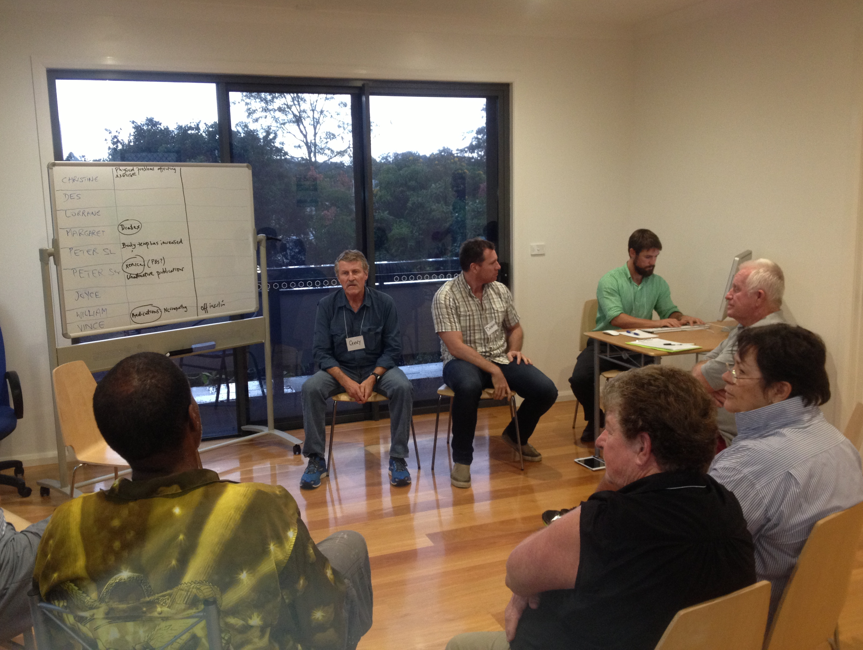
Typical set-up: Type 2 Diabetes
Doctor
Whiteboard/
Butcher’s
Paper
Documenter???
Breakout room
for personal
measures
Facilitator
Patients

Slide 10
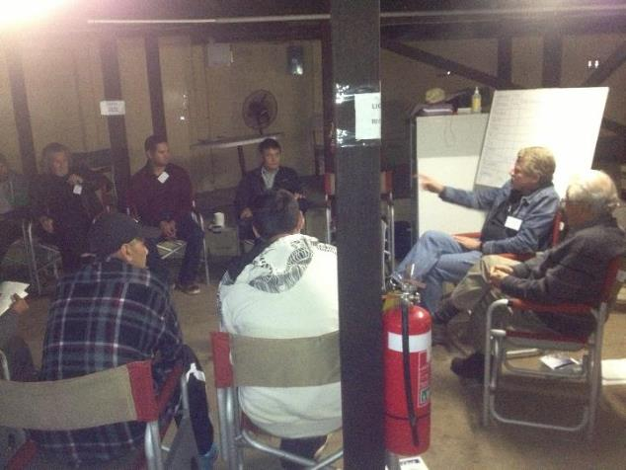
Metabolic Health – Indigenous Men
Notes: No
Documenter

Slide 11
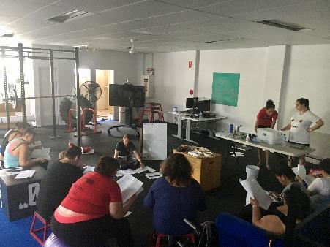
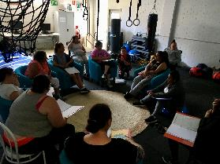
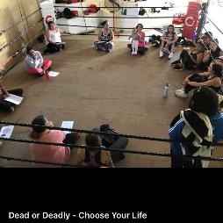
Weight Management Indigenous Women

Slide 12


Shared Medical Appointments
in early life care of mothers and babies:
The Possums programs
Dr Pamela Douglas MBBS FRACGP PhD IBCLC
Medical Director, The Possums Clinic
Associate Professor (Adjunct), Centre for Health Practice Innovation, Griffith University
Senior Lecturer, Discipline of General Practice, The University of Queensland
Ms Renee Keogh RN Grad Cert in Neonatal Intensive Care Nursing, IBCLC
Possums RN Feeds, sleep, crying; Lactation Consultant
Notes:
Welcome it’s wonderful having you here today!
Introduce myself and Renee

Slide 13
Mothers & unsettled babies

Slide 14
Characteristics and Roles of SMA Team Members
FACILITATOR
(Health/Diabetes Educator; Psychologist; Nurse; Ex Physiologist etc.)
Characteristics Roles
• Experience with groups
• Good interaction with GP
• Not condescending
• Able to shift discussion
• Sense of humour
• Time-conscious
• Aware of limitations
• Be first in room
• Set up whiteboard discussions
• Work with doctor/PN
• Move consultations along
• Limit dominant patients
• Bring out shy patients
• Keep session flowing
• Wrap up session
Noffsinger, E. ‘The ABC of group visits’. Springer, London, 2012

Slide 15
Characteristics and Roles of SMA Team Members
DOCTOR
Characteristics Roles
• Interested in change/efficiency
• Open for discussion
• Non-threatened
• Empathy
• Sense of humour?
• Respectful of health literacy
• Standard medical care
• Work with documenter/
facilitator
• Refer to PN/Facilitator for vitals
• Answer patient questions
Noffsinger, E. ‘The ABC of group visits’. Springer, London, 2012

Slide 16
Characteristics and Roles of SMA Team Members
DOCUMENTER (if feasible)
(Receptionist; Clerical person; Practice Manager; Medical student etc.)
Characteristics Roles
• Unflappable
• Knowledge of Medical Recording
computer programs
• Co-operation with GP
• Able to multi-task
• Write in medical records
• Follow GP
• Check records with GP
• Provide prescriptions etc
to patients after the group
Noffsinger, E. ‘The ABC of group visits’. Springer, London, 2012

Slide 17
Getting Started
• Confidentiality
- Use standard ‘legalised’ form
- Cover in all promotional items / facilitator’s introduction
- State that only what they want to disclose needs to be disclosed
• Costing
- MBS item numbers (23/10997 etc)/CDM eg. team care
- Health Care Homes (Group Consults Code
H00601- $40/head: H00602: $20/head for Facilitator)
- pSMAs may been to be different
- Current application to Medical Benefits Review

Slide 18
Getting Started
Space
- Room for up to 15 people (seated)
- Must be primary medical centre for MBS claims
- Breakout room optional (for taking vitals/personal examinations)
Personnel
- Should have a ‘champion’
- Doctor(s) must be on-side/ AHPs must WANT to be facilitators
- PN or allied health professionals as facilitators
Materials
- White board/ butcher’s paper/ marker pen
- name tags
- Computer with medical records open
- Handouts as required

Slide 19
Practical Demonstration

Slide 20
Practical Demonstration
Starting your SMA
Steps
1. Invite participants
2. Prepare instructions/note board
3. Discuss rules
4. Ask for questions
5. Call in the doctor

Slide 21
A typical introduction by the facilitator
“Thanks for coming to this Shared Medical Appointment. Can I first ask you
to switch off mobile phones so we won’t be interrupted in this group.
A Shared Medical Appointment is a new concept in medical care, which enables
you all to contribute to the care of each other, with the help of the doctor and
other health professionals. You’ll each have a consultation and get a chance to
ask questions of the doctor, just like a medical appointment – except that
there will be other people watching and listening and possibly also adding
their experiences to your consult. I’ll be keeping the doctor on time, which
means I’ll have to cut in if you talk too much and ask if we can move on. Hopefully
any extra questions you want to ask will come out later or from someone else.
I’ll also try to make sure that anyone who is a bit quiet gets their turn. The only
thing I ask is that you listen to everything that’s going on – contribute if you like –
but don’t talk to the person next to you or shift attention away from the
main consultation. I’m sure you’ll find everything interesting and will learn a
lot from each other.
So, let’s get the doctor in and get started.”

Slide 22
‘Rules’ of the meeting
• Turn your phones off
• Respect confidentiality of others outside this room
• Contribute your experience to other’s consultation if
you wish, but don’t talk to others in the group privately
• Ask the facilitator if you need prescriptions or to make
another 1:1 appointment

Slide 23
Results Board/Sheet
HBA₁C FPG Tg BP Questions?
Feeling tired all the time
Lack of interest in things generally
Needing to go to the toilet, worse at night
John B
7.9 13.0 4.2 125/85
11.1 15.5 1.9 160/94
8.3 9.4 3.2 180/100
Gaining weight for no reason
Hungry all the time and more thirsty
Getting more headaches than usual
Jenny K
No interest in sex and generally listless
Tingling in the legs and feet
Feeling moody and irritable
Chris N
………..
……………………………………….

Slide 24
Lessons Learned in Practice
• Make sure you have administrative support
• Make sure everyone on the clinic knows what you are doing
• Ensure target numbers (‘census’) and overbook to get these
• Start and finish on time/Make sure patients can stay until the end
• Foster group interaction
• Advise patients to stay seated if possible, or stand in the one spot
• Make sure doctor can come in when needed and leaves after set time
• De-brief with patients (on sticky notes) and with SMA ‘team’

Slide 25
Video 2
Common Situations
(Geoff Harding- Long)
https://youtu.be/kCOfeVmVw3M

Slide 26
Q&A
E/J

Slide 27
www.lifestylemedicine.org.au

