Slide 1
Session 3
‘Doing’ SMA

Slide 2
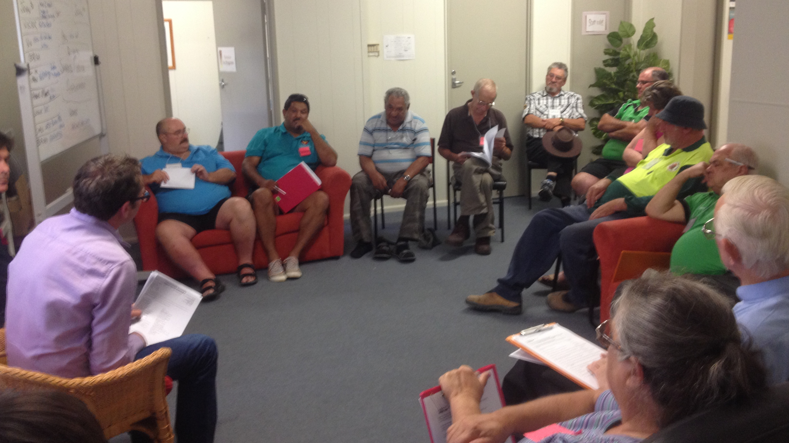
Session 3: DOING IT

Slide 3
Session 3: Objectives
At the end of this session participants will…
Experience role playing an SMA
Evaluate their role play
Explore useful tips to successful SMAs
Understand the PSMA
Plan setting up an SMA in their practice

Slide 4
Quick revisit:
Shared Medical Appointments (SMAS)
“..individual medical consultations carried out sequentially
with a number of patients, administered by a skilled
Facilitator, with others with similar concerns listening
and contributing. ”
8-15 pts
SMA TEAM @ 90 min
Doctor
Facilitator
Practice Nurse
Documenter

Slide 5
Role Play Running Sheet
The scenario: First SMA for non compliant, low literacy, established T2DM.
The roles:
1 x GP played by Presenter/GP
1 x Facilitator played by alternating participants
X patients played by participants with T2DM issues to ask the Dr – using palm card roles
The Facilitated Scenes:
Invite the participants in & explain SMA and the rules – alternate
Ask the patients what they would like to consult the Dr about today, use the data board– alternate
Invite the GP in and begin with the first 2 patients – alternate
Continue the SMA as above x 2 patients (continue this depending on the number of participants) - alternate
Wrap up – final ideas and evaluate
The personalities examples: (allocate among the group -only play your personality card once…or twice)
The Interrupter
The PhD in Celebrity Magazine Advice
The normal majority

Slide 6
Practical Role Play
STEPS
Prepare room and data board
Invite participants in
Discuss rules of SMA
Ask questions of patients and add to data board
Invite practitioner in (pre-organise medical records and note taking)
Manage the SMA interactions
Move practitioner on and out
Close the SMA – debrief with patients
‘Continuous Improvement’ Debrief the SMA Team

Slide 7
‘Rules’ of the meeting
• Turn your phones off
• Respect confidentiality of others outside this room
• Contribute your experience to other’s consultation if
you wish, but don’t talk to others in the group privately
• Ask the facilitator if you need prescriptions or to make
another 1:1 appointment

Slide 8
Results Board/Sheet
HBA₁C BMI BP Questions?
I have a ulcer on my ankle that wont
go away
Adrian
7.9 30.2 125/85
11.1 38.5 160/94
12.9 36.5 180/100
Gaining weight for no reason
Hungry all the time and more thirsty
Juliet
You said that I am on the verge of needing
take insulin injections what can I do to
prevent this
Tinh
Linda 7.0 29.9 130/85
Started rigorous exercise - checking in

Slide 9
Evaluation
• De-brief with your SMA patient group (sticky notes on data board?):
“What did you think of this session?”
“ What would you like to see more of?”
“What would you like to see less of?”
“Would you come again? How regularly?

Slide 10
Continuous Improvement Debrief: Doctor & Facilitator
At the end of EVERY SMA debrief with doctor (and staff where appropriate).
Were there any safety concerns?
Are there any patients who need to be followed up with directly
What worked? What didn’t work?
What could be done better next time?
Where there any knowledge gaps?
What action steps are going to be taken to fill these?
Take notes, allocate tasks between doctor & facilitator and set action dates by which tasks will be completed for continuous improvement.

Slide 11
Role play debrief/reflection
• “What did you think of this session?”
“What surprised you the most?”
“What do you need to work on?”
“What help do you need with?

Slide 12
Tips for Facilitators
• Don’t say that you’ve read something somewhere –
only speak up if you have information that is evidence-based
• Don’t EVER disagree with the doctor – discuss any concerns with them in the ‘continuous improvement’ de-brief later
• Know what you don’t know – never interrupt on a topic
where you can’t cite evidence or direct experience for what you say.
• Check with the doctor that it’s alright to add information
when you think you have something important to add.
• If people start to talk amongst themselves or disrupt
the group, politely ask them to keep the conversation
until later as they might be missing something.

Slide 13
Tips for Facilitators (cont..)
Try to keep the initial consultations on time to keep within the hour. If these first patients take too long, those at the end will be rushed and may feel cheated by not getting their share.
If the occasion arises ie. a patient has tried something that works for them, or has something unusual, ask the rest of the group if anyone else has done/had that and how they dealt with it.
Roll with resistance – don’t get into an argument with a patient
REMEMBER: “ It takes years for someone to find out what you know, but only one sentence to find out what you don’t.”

Slide 14
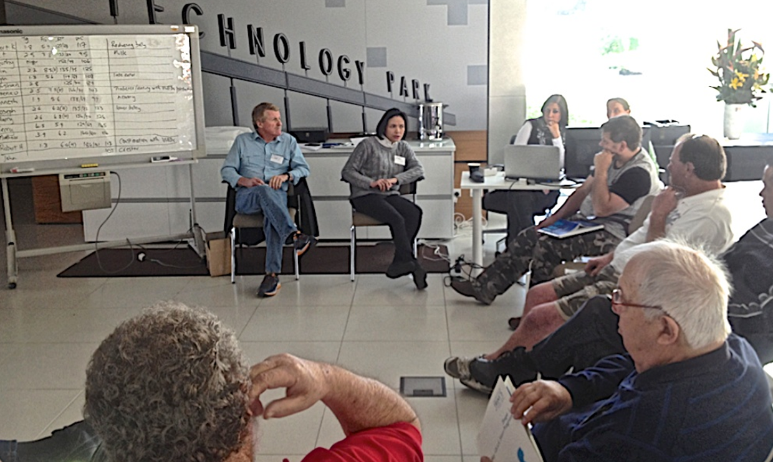
PROGRAMMED SHARED MEDICAL APPOINTMENTS (PSMA)

Slide 15
Shared Medical Appointments (SMAS)
“..individual medical consultations carried out sequentially
with a number of patients, administered by a skilled
Facilitator, with others with similar concerns listening
and contributing. ”
8-15 pts
SMA TEAM @ 90 min
Doctor
Facilitator
Practice Nurse
Documenter

Slide 16
PSMA Defined
… a sequence of Shared Medical Appointments in a semi-structured form providing discrete educational input relating to a specific topic (Egger & Stevens 2017).

Slide 17
SMA + Specific program = PSMA

Slide 18
PROGRAMS UNDER CONSTRUCTION Facilitator Training and Patient Programs
Weight Control https://lifestylemedicineprograms.com/
Chronic Pain
Smoking Cessation
Type 2 Diabetes
Stress, Anxiety and Depression
Mothers and Unsettled Babies
Indigenous Health
Cancer Survivors
Primary care Cardiac Rehab

Slide 19
PSMA: Weight Control
An Example

Slide 20
SMA + Weight Control Program = Happier & Healthier Life

Slide 21
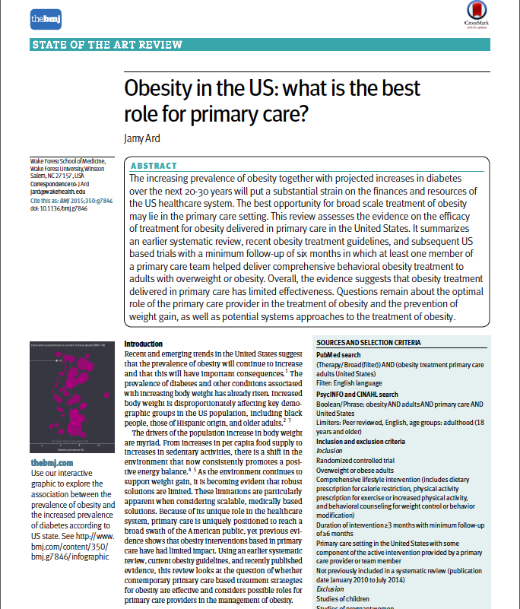
“Overall, the evidence suggests that obesity treatment
delivered in primary care has limited effectiveness.”
(but)”….given the influence and reach of primary care
providers we cannot afford for them to be sidelined in the
treatment of obesity in larger populations.”
Ard, J., BMJ 2015;350:g7846

Slide 22
Potential cost effectiveness
In one systematic review:
11-26 visits over 1 year lead to;
4-7kg more weight loss than controls after 1 year (Ard et al., 2015)
If the same result can be achieved using 8 PSMA sessions (10 patients/session)
would save the GP 37 hours of his/her time
AND
the patient would have twice as long with the doctor + peer support
* Therefore: SMAs (for weight control) are 75% more cost-effective and 85% more time-effective as 1:1 consulting

Slide 23
Programmed Shared Medical Appointment: Weight Control

Slide 24
PSMA: Weight Control Video - Milton
https://youtu.be/adRTBmEMHUo

