Slide 1
Setting up and Implementing SMAs in your practice

Slide 2
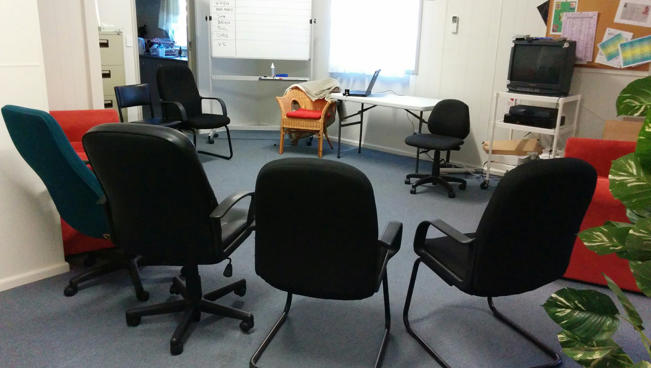
Design your SMA thoughtfully

Slide 3
Your goal with each SMA
“..individual medical consultations carried out sequentially
with a number of patients, administered by a skilled
Facilitator, with others with similar concerns listening
and contributing. ”
8-15 pts
SMA TEAM @ 90 min
Doctor
Facilitator
Practice Nurse
Documenter

Slide 4
What type of SMA will you run?
Generic Type Composition
Physical Shared Medical
Appointments (PSMAs)
Includes a range of physical tests
by GP or PN in ‘breakout’ room
Heterogeneous Homogeneous
Shared Medical
Appointments
(SMAs):
Medical and Allied
Health consultation
and group session
with 6-12 patients
Varying gender/
age/ailment etc.
Pts with different
types of chronic
disease with
similar lifestyle
causes
(T2D; CHD,
COPD etc)
Similar ailment
or background
eg. T2D;
Indigenous men/
women; elderly
Programmed Shared
Medical Appointments
(pSMAs)
Ie. weight loss, smoking, pain,
restless babies, Type 2 diabetes etc.
Drop in Group Medical
Appointments
(DIGMAs):
Medical and Allied Health
consultation and group
session with 6-12 patients
Egger, G. et al., AFP, 2014, 43:3, 151-154

Slide 5
SMA types: examples
Pediatric Diabetes | Cardiology (Preventative)
Pre-Diabetes care | Osteoporosis
Asthma | Sleep Medicine (CPAP)
Menopause | Pediatric Rheumatology
Wellness | CHF and Discharge
Pain Management | Weight Management
Adolescent weight | Diabetic foot care
PMSF | Medical Nutrition
Macular degeneration | Stroke
Diabetes | Heel pain
Bariatric | Psychiatry : Mood Disorders
Notes:
This shows the diversity and high lights the mix between primary care, preventative and specialties and areas we currently have SMA’s embedded into practice

Slide 6
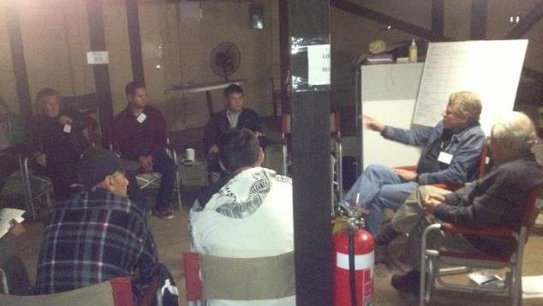
Design your SMA around the outcomes you want considering…
1) the clients you can recruit
2) the resources you have.

Slide 7
Recruiting the patients you want
The 4 M’s
• MARKET
- Homogeneous/heterogeneous group
- T2DM; Arthritis; Obesity; Indigenous health; New borns etc
• MEDIA
- patient brochures/posters/fliers/handouts
- local media; You-tube
• MESSAGE
- Peer support program with doctor
- Different/fun
• METHOD
-Direct invitation at consult
-SMSs/e-mails through Medical Reporting Program
- other ???

Slide 8
Promote/recruit effectively: examples
Send announcement letter to Pts at start of SMA
Framed wall posters in MD’s lobby/exam rooms
Program description fliers
Have Pts invited by:
Doctors
Nurse (fliers)
Receptionists (invitations)
GP must personally invite all appropriate Pts seen in office visits (Most important step, but should only take 30-60”)

Slide 9
Promotional flier/poster example

Slide 10
Resourcing your SMA
The 4 P’s
• PERSONNEL
- Need a ‘champion’/receptionist
- Invites from Doctor
• PRODUCT
- USPs for Pts: peer support; more time with doctor
- USP for Clinicians: no repetition; peer support; more
relaxing; more fun
• PRICE
- Covered by item 23 if bulk billing
- Co-payment for specific programs (eg. weight control)
• PLACE
- Room size to cope with 8 – 15 people (Pts + clinicians)
- Semi-circle seating

Slide 11
Operational Challenges
Introduce change
Major paradigm shift
Magnifies system probs.
Physician & Pt buy-In
Training & confidentiality
Personnel requirements
Group & exam rooms
Must promote effectively
Competing resource needs
Ongoing evaluation
Launch targeted # / Year
Maintain minimum numbers
Stay on model

Slide 12
Discussion
What sort of SMA in your place and why?

Slide 13
Q&A
Red Flags
E/J

Slide 14
www.lifestylemedicine.org.au

